Slide 1
ITECH 5404 Business Process Analytics and Change
Team member:
Binay Maharjan 30372506
Nazmul Ahasan 30367655
Alina Nepali 30369564
Sandip Lama 30367063
Kazi Samir Zahedi 30367032

Slide 2
BPM
Business Process Model and Notation (BPMN) is a graphical representation for specifying business processes in a business process model. Business Process Management Initiative (BPMI) developed BPMN, which has been maintained by the Object Management Group since the two organizations merged in 2005.

Slide 3
Activities Flow for order fulfillment process from supplier end to logistic
Sales Order received from Finance department
Finance Department Issues picking ticket
Waiting time for suppliers to confirm order is set between 2 to 5 working days (depending on the volume and requirement of client’s delivery). Confirmed order is sent back to Procurement Department to raise quote for new suppliers for delivery of order based on picking ticket.
Once the picking ticket is forwarded to the suppliers for request to deliver on credit
Supplier once approves the credit request, delivers the products to the logistics department in accordance with the requirements of the picking ticket
However, if the credit request is not approved by the supplier, the order is sent to procurement department to negotiate with supplier
Completed picking ticket is delivered to logistics department after successful negotiation. In case of unsuccessful negotiation, new suppliers are approached with RFQ and order fulfillment process is completed between finance and logistics by successful delivery of completed picking ticket by supplier to the logistic department

Slide 4
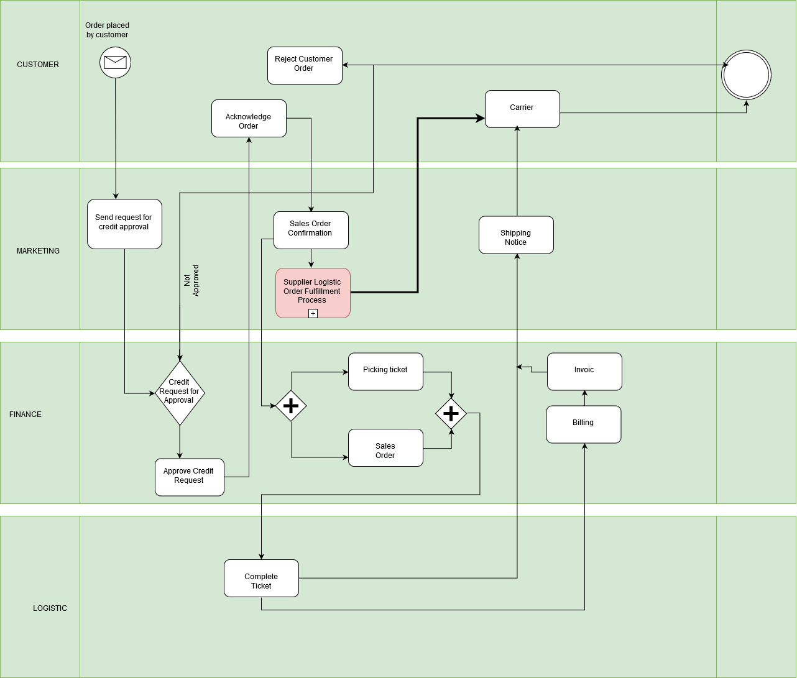

Slide 5
Activities Flow for order fulfillment process ;From Financial to Customer
1 | Process started
2 | Customer orders the item
3 | Here the company and the customer both acknowledges the service being conducted
4a | The credit validation is done if not then goes to another path that is 4b which is the end of transaction meanwhile, the message is sent for acknowledgment
4b
5 | Here the market gets acknowledge if credit is low then rejects the customer order and whole process is ended
6 | If not then process is forwarded for confirmation
7 | Where the picking order is followed parallel to logistic part
8 | Ticket is completed
9 | Billing confirmation is done at this step
10 | If there is any tax charge or any additional charges
11 | Or product version is upgraded or modified
12 | Invoice is created
13 | Details are checked if mismatch then no invoice is formed
14 | Final invoice is generated
15 | Any error/mismatch is handled by financial manager
16 | Shipping notice created
17 | Following the carrier the item is deliver and process is ended

Slide 6
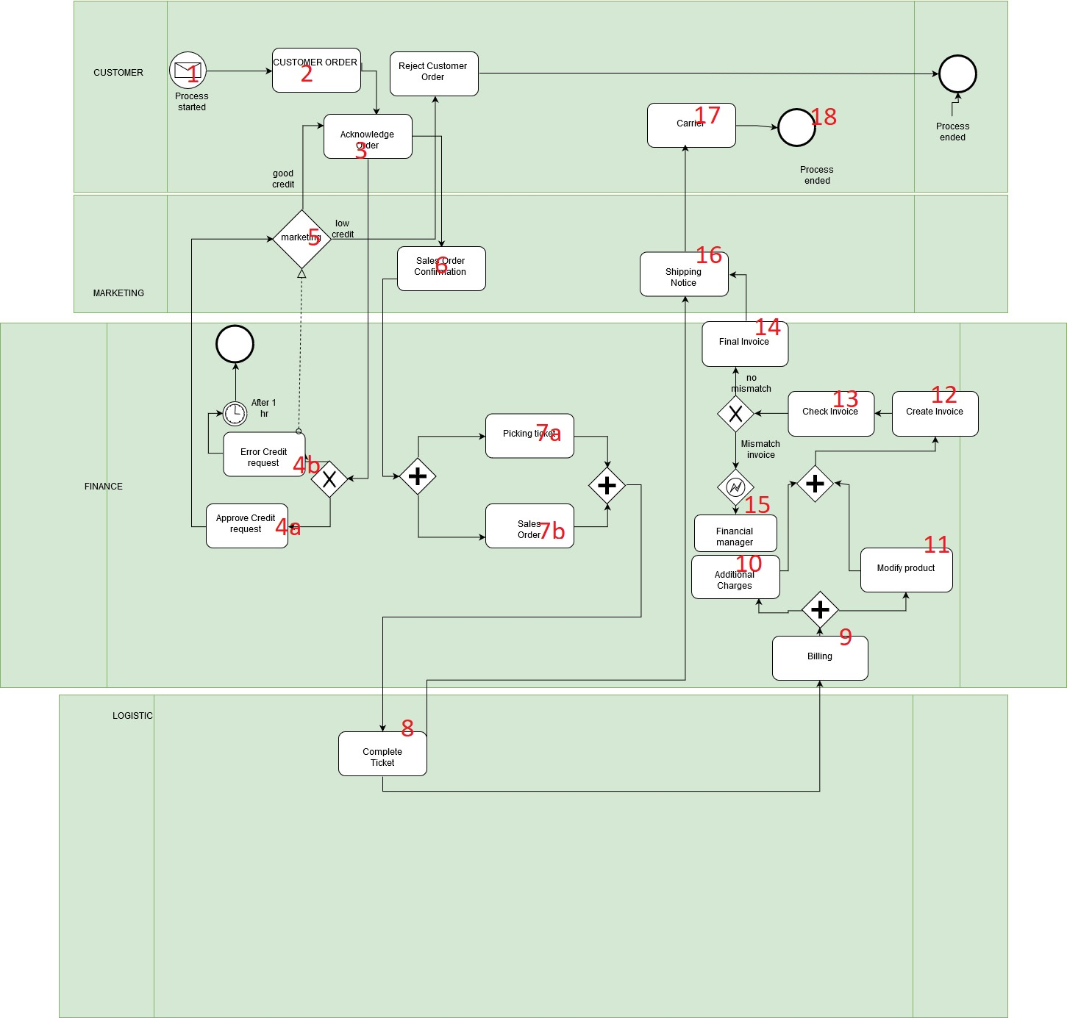
`

Slide 7
Activities Flow for order fulfillment process ;From Logistic to Customer
Ticket send from finance to logistics’ warehouse
Warehouse completed picking ticket and forward it to shipping department
Shipping department send delivery date to the marketing department and the marketing
department contact with the customer in order to tell delivery date
Shipping department send shipping notice to the finance and marketing department when
the order send to the carrier.
Finally, when the carrier delivered the order to the customer, the carrier send the delivery
confirmation to the marketing department.

Slide 8
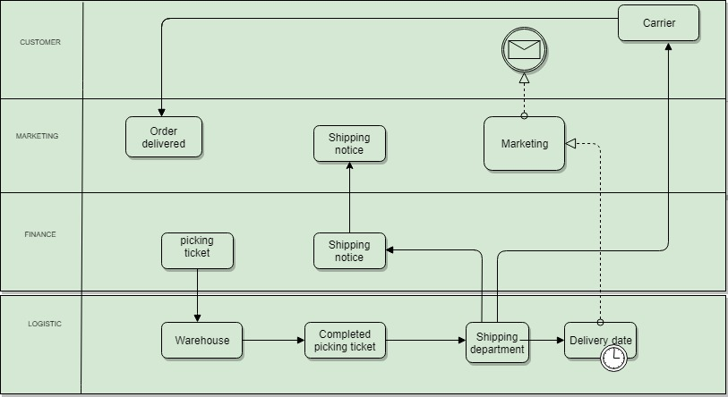

Slide 9
Benefits
Capture and Document. The BPMN modeling standard provides the ability for business analysts to capture and document business processes from different sources in a clear and consistent way.
Communicate and Collaborate.
Analyze and Execute. .
Improve Process Performance.

